Slide 1
European Exploration Brings Change
By 1500, the European economy was becoming more commercialized and industrialized
By 1600, economic reforms and practices were in progress in many European states
By 1600, financial reform was needed
In 1609, the Dutch established the Bank of Amsterdam, making the city a commercial and financial center of Europe
By 1700, trade linked the continents of Europe, Asia, Africa and the Americas in a new global economy

Slide 2
Effects on Non-Europeans
Diseases devastated African and indigenous populations
International politics began to change
Changes in racial make-ups began to occur as Europeans began to intermarry with the indigenous population
Importation of African slaves as labor
Exchange of plants and animals

Slide 3
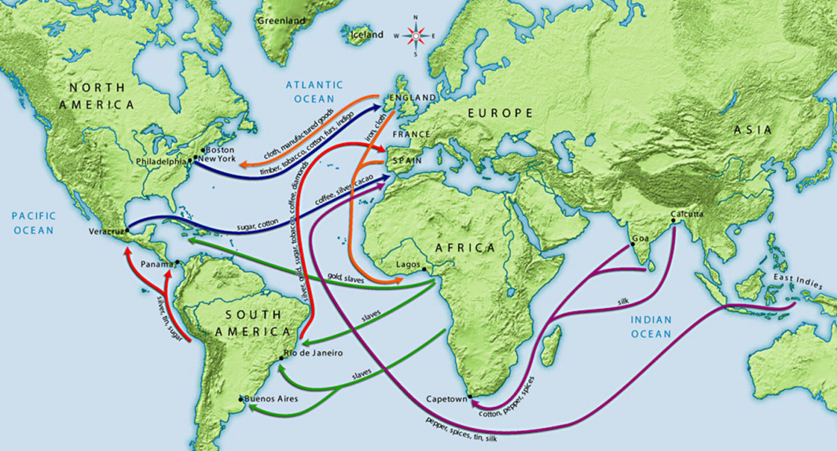
Global Commerce
The establishment of the global economy allowed for merchant and product diversity
Empires based on wealth began to emerge
Allowed for the trade of various goods from around the world

Slide 4
The Silver Trade
Traded on the same level as spices
Used as a form of payment for traded goods
Large deposits of silver discovered in Mesoamerica, South America, and Japan
By 1700, nearly 85% of silver was produced in the Spanish American colonies
Spanish coins, known as pieces of eight, became widely used in trade

Slide 5
Spanish and the Silver Trade
Created an influx of Spanish immigrants to Spanish colonies in the Americas
Helped create a hierarchical Spanish society in its American colonies
Created great wealth for Spain
Much of the wealth was spent on building projects, such as churches and their adornments

Slide 6
Silver in Asia
Japan became a major producer of silver
Used by Tokugawa rulers in Japan to conquer their neighbors and unite the country
Use of silver in China led to a highly commercialized economy
Required as payment of taxes by the Chinese government

Slide 7
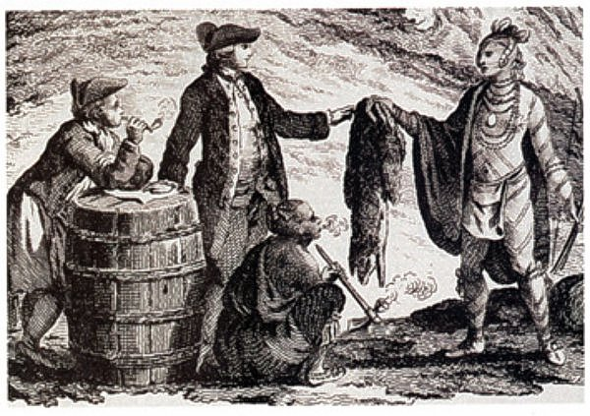
The Fur Trade
By the 17th century, furs had become part of the global economy
High demand of furs in Europe, China, Russia and the Ottoman Empire led to increased prices
Most furs came from North America and Russia
Europeans traded with local populations for furs

Slide 8
Effects of the Fur Trade
Initially led to prosperity among the local populations
Allowed for cultural interaction through trade
Greatly diminished the population of fur bearing animals, which led to a diminished local economy
Introduced European diseases to local populations

Slide 9
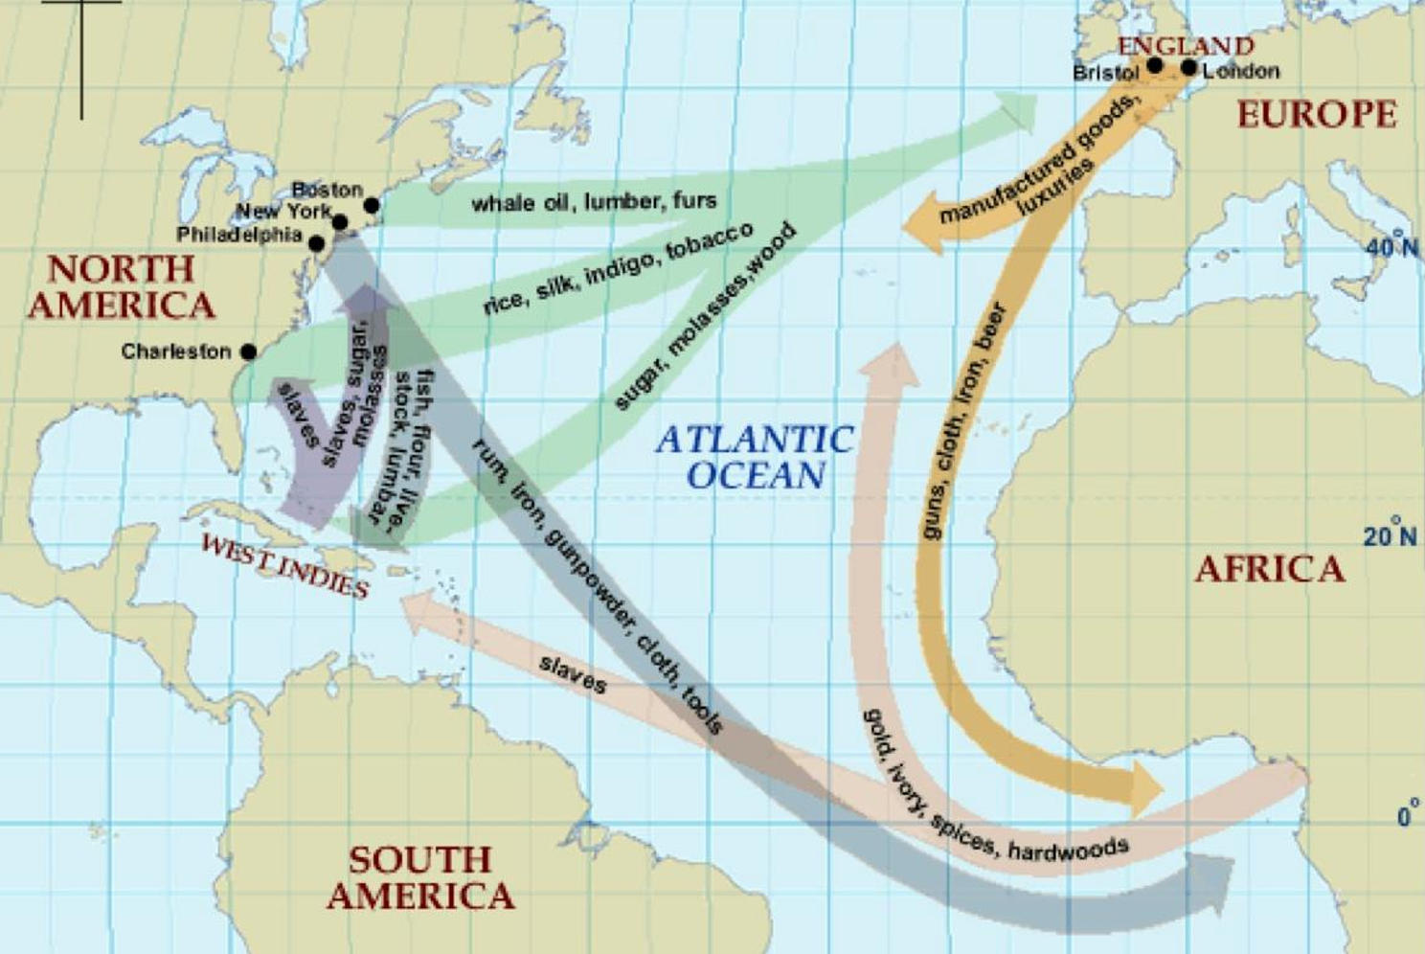
Atlantic Triangular Trade

Slide 10
The Atlantic Triangle
European merchant ships transported European manufactured goods, such as rum, textiles and tools to Africa to be traded at local markets for gold, ivory and slaves
Slaves were transported to the Americas where they were sold or traded for goods
Goods from the Americas, such as sugar, tobacco, rum, coffee and cotton were transported to Europe were they were sold on European markets for profit

Slide 11
Slavery in the Americas
By 1600, nearly 275,000 African slaves had been exported from Africa to Europe, the Middle East and the Americas
About 2,000 per year were sent to the Americas
By 1700, nearly 6 million African slaves had been brought to the Americas
By 1800, that number had grown to nearly ten million
10 – 15% of all African slaves died during the “Middle Passage” from malnutrition and disease

Slide 12
Cost of Slavery
Depopulated African tribes
Pitted local tribes against each other in order to furnish slaves to the Europeans
Cheap European goods undermined local industries and created widespread poverty
The use of African slaves became widely accepted in Europe as they were seen as inferior to white Europeans

Slide 13
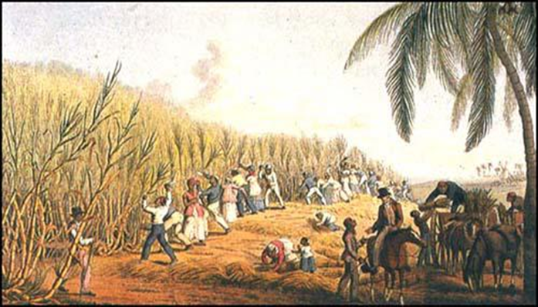
Europeans and Sugar
Introduced in Europe during the 1st Crusade in the late 11th century
By the 16th century, the Portuguese and Spanish had established sugar plantations in the Americas
Sugar production was very labor intensive but very profitable
Led to establishment of the Triangular Trade system and African slavery

Slide 14
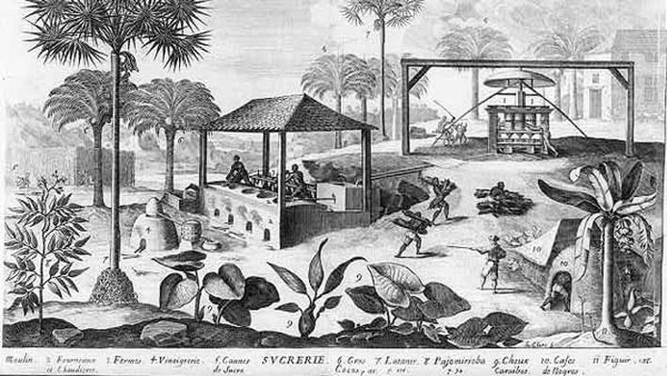
The Sugar Trade
1st sugar harvest was in Hispaniola in 1501
By 1550 over 3,000 sugar mills were in operation
European demand continually increase
By 1750, sugar was valued in trade more than grains

Slide 15
The Sugar Trade
By 1700, the West Indies produced more sugar than Brazil
80 – 90% of all sugar consumed in Europe was produced in the Americas
Higher demand led to the expansion of plantations and importation of more slaves
The sugar industry gave rise to other commodities, such as molasses and rum

